Slide 1
Quantum Information Theory
Week 1: setting the story

Slide 2
What relevant courses have you studied
Quantum computing?
Quantum optics?
Intro to quantum technologies overview course?

Slide 3
Why study Quantum Information Theory?

Slide 4
Why study Physics? (rather than, say, Chemistry)

Slide 5
Why study Physics?
Two overarching themes within physics.
The first theme is that physics studies universal properties of nature. We expect that black holes in the cores of galaxies a billion light years away obey the same laws of general relativity that govern the motion of planets in our own solar system, or the motion of a ball through the air. Likewise, we expect that the structure of matter based upon quarks and leptons is the same throughout the universe.
A second overarching theme of physics is the reduction of phenomena. Key to this is the ongoing search for simplified, unified frameworks in which it is possible to understand more complicated phenomena.
(Intro of PhD thesis of Nielson)

Slide 6
Why study quantum information theory?

Slide 7
What is quantum information theory?

Slide 8
What is information theory?
Information is physical (Landauer)
i.e. any real information processing system is necessarily performed by physical systems governed by the laws of physics

Slide 9
What is information theory?
Information is physical (Landauer)
i.e. any real information processing system is necessarily performed by physical systems governed by the laws of physics
Information theory is the study of this connection

Slide 10
What is information theory?
Information is physical (Landauer)
i.e. any real information processing system is necessarily performed by physical systems governed by the laws of physics
Information theory is the study of this connection
Valuable to understand the power and limits of computations and communication

Slide 11
What is information theory?
Information is physical (Landauer)
i.e. any real information processing system is necessarily performed by physical systems governed by the laws of physics.
Information theory is the study of this connection
Valuable to understand the power and limits of computations and communication
But ‘information’ also at the core of an (operational) understanding of nature therefore information theory provides a universal account of nature.

Slide 12
What is quantum information theory?
Information is physical (Landauer)
i.e. any real information processing system is necessarily performed by physical systems governed by the laws of physics (which obey quantum mechanics!)
Information theory is the study of this connection
Valuable to understand the power and limits of computations and communication
But ‘quantum information’ also at the core of an (operational) understanding of nature therefore information theory provides a universal account of nature.

Slide 13
What is quantum information theory?
“Quantum information is the study of the information processing tasks that can be accomplished using quantum mechanical systems.”
(Nielson & Chuang – AKA the bible of QIT)

Slide 14
What is quantum information theory?
“Quantum information is the study of the information processing tasks that can be accomplished using quantum mechanical systems.”
(Nielson & Chuang – AKA the bible of QIT)
Information is everything! It’s all we have! (At least within an operational understanding of the universe… and this is a powerful perspective to take)

Slide 15
What is quantum information theory?
“Quantum information is the study of the information processing tasks that can be accomplished using quantum mechanical systems.”
(Nielson & Chuang – AKA the bible of QIT)
Information is everything! It’s all we have! (At least within an operational understanding of the universe… and this is a powerful perspective to take)
Quantum information theory is an interdisciplinary field that involves quantum mechanics, computer science, information theory, philosophy and cryptography among other fields. Its study is also relevant to disciplines such as cognitive science, psychology and neuroscience.”
(Wikipedia)

Slide 16
What is quantum information theory?
“Quantum information is the study of the information processing tasks that can be accomplished using quantum mechanical systems.”
(Nielson & Chuang – AKA the bible of QIT)
Information is everything! It’s all we have! (At least within an operational understanding of the universe… and this is a powerful perspective to take)
Quantum information theory is an interdisciplinary field that involves quantum mechanics, computer science, information theory, philosophy and cryptography among other fields. Its study is also relevant to disciplines such as cognitive science, psychology and neuroscience.”
(Wikipedia)

Slide 17
What is quantum information theory?
“Quantum information is the study of the information processing tasks that can be accomplished using quantum mechanical systems.”
(Nielson & Chuang – AKA the bible of QIT)
Information is everything! It’s all we have! (At least within an operational understanding of the universe… and this is a powerful perspective to take)
Quantum information theory is an interdisciplinary field that involves quantum mechanics, computer science, information theory, philosophy and cryptography among other fields. Its study is also relevant to disciplines such as cognitive science, psychology and neuroscience.”
(Wikipedia)

Slide 18
Why study quantum information theory?

Slide 19
Why study quantum information theory?
Very powerful and general account (can be applied to lots of systems of interest)
A two level atom
A spin
H/V polarized Qubit
Left or right path

Slide 20
Why study quantum information theory?
Very powerful and general account (can be applied to lots of systems of interest)
A bit like the switch from:
2 berries + 3 berries = 5 berries
2 dogs + 3 dogs = 5 dogs 2 + 3 = 5
2 fire + 3 fires = 5 fires

Slide 21
Why study quantum information theory?
Very powerful and general account (can be applied to lots of systems of interest)
Gets at the foundations of how the universe behaves

Slide 22
Why study quantum information theory?
Very powerful and general account (can be applied to lots of systems of interest)
Gets at the foundations of how the universe behaves
Provides fundamental limits on how quantum systems can interact…
The correlations that exist between them…
The information that it’s possible to extract from them…

Slide 23
Why study quantum information theory?
Very powerful and general account (can be applied to lots of systems of interest)
Gets at the foundations of how the universe behaves
Can manipulate these rules for our own benefit for new technologies

Slide 24
Why study quantum information theory?
Very powerful and general account (can be applied to lots of systems of interest)
Gets at the foundations of how the universe behaves
Can manipulate these rules for our own benefit for new technologies
Provides a useful toolkit for analyzing quantum technologies and quantum systems

Slide 25
Why study quantum information theory?
Very powerful and general account (can be applied to lots of systems of interest)
Gets at the foundations of how the universe behaves
Can manipulate these rules for our own benefit for new technologies
Provides a useful toolkit for analyzing quantum technologies and quantum systems

Slide 26
Overview of course
Part 1 (approx. half): The Basics (from a more advanced perspective)
Classical versus Quantum States
Quantum measurements (POVMS)
Quantum channels (Kraus, Stinespring and Choi representations)
Brief fun interlude: The measurement problem
Part 2: ’Ways of getting information out of a quantum state/process’
Distinguishing quantum states
Shot noise
State and process tomography
Measures of information
Part 3: Entanglement Theory
Resource theory of entanglement
Witnessing/distilling entanglement
The problem of mixed state entanglement

Slide 27
How will this Quantum Information course be different from:
Vincenzo Savona’s ‘Quantum Information and Quantum Computing’ course
& Jean-Philippe Brantut’s ‘Quantum Optics and Quantum Information’ course?

Slide 28
How will this Quantum Information course be different from:
Vincenzo Savona’s ‘Quantum Information and Quantum Computing’ course
& Jean-Philippe Brantut’s ‘Quantum Optics and Quantum Information’ course?
‘Advanced pure QI focus’ (less on quantum computing / open quantum systems)

Slide 29
Overview of course
Part 1 (approx. half): The Basics (from a more advanced perspective)
Classical versus Quantum States
Quantum measurements (POVMS)
Quantum channels (Kraus, Stinespring and Choi representations)
Brief fun interlude: The measurement problem
Part 2: ’Ways of getting information out of a quantum state/process’
Distinguishing quantum states
Shot noise
State and process tomography
Measures of information
Part 3: Entanglement Theory
Resource theory of entanglement
Witnessing/distilling entanglement
The problem of mixed state entanglement
Material not in their courses

Slide 30
Overview of course
Part 1 (approx. half): The Basics (from a more advanced perspective)
Classical versus Quantum States
Quantum measurements (POVMS)
Quantum channels (Kraus, Stinespring and Choi representations)
Brief fun interlude: The measurement problem
Part 2: ’Ways of getting information out of a quantum state/process’
Distinguishing quantum states
Shot noise
State and process tomography
Measures of information
Part 3: Entanglement Theory
Resource theory of entanglement
Witnessing/distilling entanglement
The problem of mixed state entanglement
Overlap!

Slide 31
How will this Quantum Information course be different from:
Vincenzo Savona’s ‘Quantum Information and Quantum Computing’ course
& Jean-Philippe Brantut’s ‘Quantum Optics and Quantum Information’ course?
‘Advanced pure QI focus’ (less on quantum computing / open quantum systems)
Basics characterized by an ‘operational’ perspective

Slide 32
How will this Quantum Information course be different from:
Vincenzo Savona’s ‘Quantum Information and Quantum Computing’ course
& Jean-Philippe Brantut’s ‘Quantum Optics and Quantum Information’ course?
Advanced pure QI focus’ (less on quantum computing / open quantum systems)
Basics characterized by an ‘operational’ perspective
More analytics focused (than e.g. Vincenzo’s)

Slide 33
How will this Quantum Information course be different from:
Vincenzo Savona’s ‘Quantum Information and Quantum Computing’ course
& Jean-Philippe Brantut’s ‘Quantum Optics and Quantum Information’ course?
Advanced pure QI focus’ (less on quantum computing / open quantum systems)
Basics characterized by an ‘operational’ perspective
More analytics focused (than e.g. Vincenzo’s)
Foundational/philosophical angle occasionally

Slide 34
Overview of course
Part 1 (approx. half): The Basics (from a more advanced perspective)
Classical versus Quantum States
Quantum measurements (POVMS)
Quantum channels (Kraus, Stinespring and Choi representations)
Brief fun interlude: The measurement problem
Part 2: ’Ways of getting information out of a quantum state/process’
Distinguishing quantum states
Shot noise
State and process tomography
Measures of information
Part 3: Entanglement Theory
Resource theory of entanglement
Witnessing/distilling entanglement
The problem of mixed state entanglement

Slide 35
Logistics
Will be assessed by assessed problem sheets and an exam
Each week there will be a set of class problems. Sometimes at the end of the problem there will be an assessed problem.
This will not be set straight away but instead is there to give you a head start.
Rather these problems will be combined into two set problem sheets.
In both cases you will be give 2 weeks notice to submit them.
But I highly recommend you make a start on them earlier! While the material is fresh from class.
(You are also very welcome to work collaboratively on the problems)
I will sometimes move the lectures to the problem class slot. (Lectures from last year were recorded so you can watch those if you cannot make the problem class slot).
Any questions?

Slide 36

Operational approach to Quantum Information Theory
à la David Jennings

Slide 37
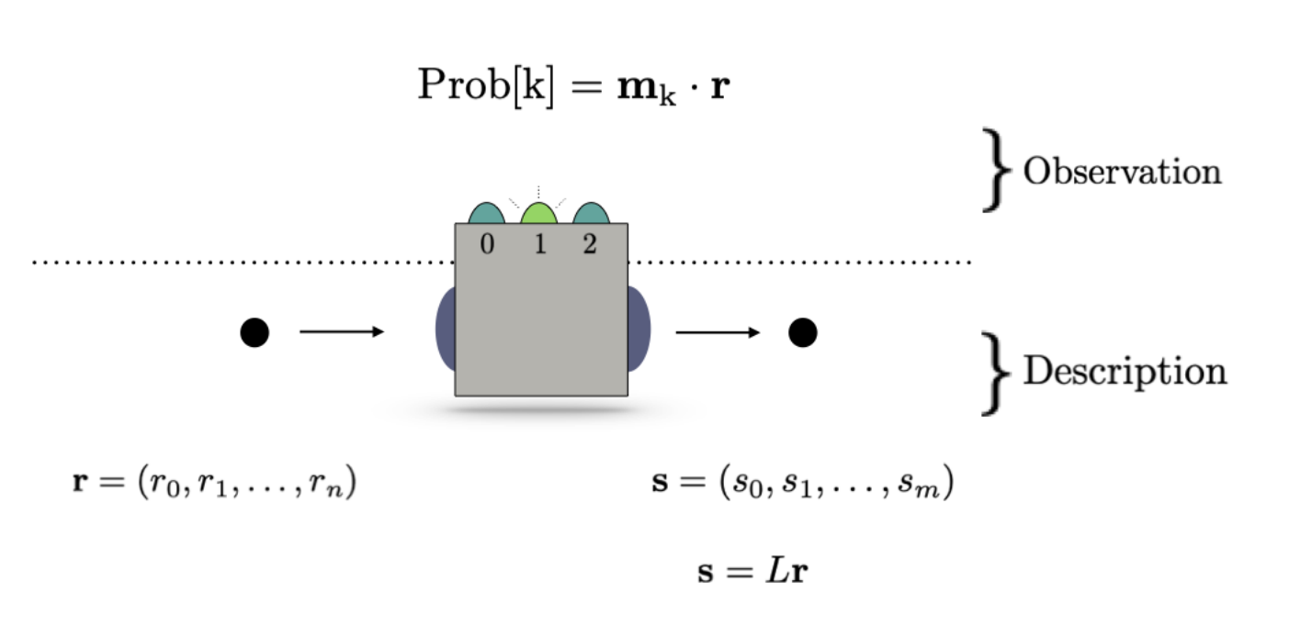
Operational approach to Quantum Information Theory
Ultimately all we have access to is measurement outcomes so let’s formulate our theory of everything based around this principle

Slide 38
Operational approach to Quantum Information Theory
Formulate concepts through concrete actions a human can do and the empirical statistics observed.
Ultimately all we have access to is measurement outcomes so let’s formulate our theory of everything based around this principle

Slide 39
Operational approach to Quantum Information Theory
Formulate concepts through concrete actions a human can do and the empirical statistics observed.
Ultimately all we have access to is measurement outcomes so let’s formulate our theory of everything based around this principle

Slide 40
Operational approach to Quantum Information Theory
Formulate concepts through concrete actions a human can do and the empirical statistics observed.
Probabilities are central to the description.
P(k)

Slide 41
Operational approach to Quantum Information Theory
Formulate concepts through concrete actions a human can do and the empirical statistics observed.
Probabilities are central to the description.
Start with classical theory of states, operations and measurements on classical systems
P(k)
P(k)

Slide 42
Operational approach to Quantum Information Theory
Formulate concepts through concrete actions a human can do and the empirical statistics observed.
Probabilities are central to the description.
Start with classical theory of states, operations and measurements on classical systems
Show what changes when we deal with quantum systems
P(k)

Slide 43
Operational approach to Quantum Information Theory
Formulate concepts through concrete actions a human can do and the empirical statistics observed.
Probabilities are central to the description.
Start with classical theory of states, operations and measurements on classical systems
Show what changes when we deal with quantum systems
Build on from there…

Slide 44
Operational approach to Quantum Information Theory
Formulate concepts through concrete actions a human can do and the empirical statistics observed.
Probabilities are central to the description.
Start with classical theory of states, operations and measurements on classical systems
Show what changes when we deal with quantum systems
Build on from there…
(For a more conventional approach check out Jean-Philippe’s lectures… or the first chapters of N&C or J&J or my lecture notes from the Intro to QT Master’s course)
à la David Jennings

Slide 45
Systems vs. states
What is a system?
(Peres)

Slide 46
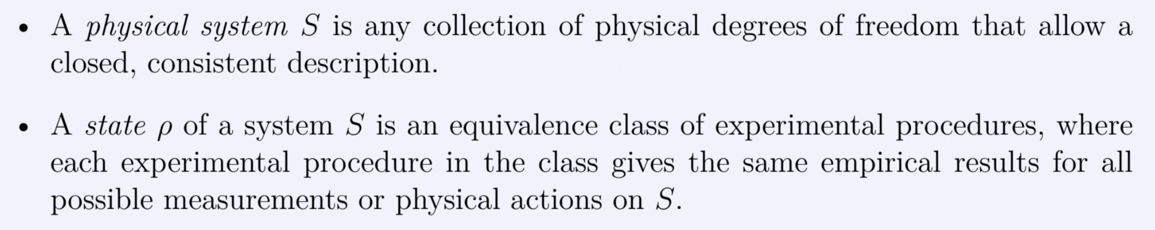
Systems vs. states
What is a system is super slippery to pin down!
But in practice we normally have a good sense of what counts as a systems
It’s the stuff all around us that form the basic building blocks of physics

Slide 47
Systems vs. states
What is a state?
(Peres)

Slide 48
Systems vs. states
States easier to get a handle on!

Slide 49
Systems vs. states
States easier to get a handle on!
Ground state of an atom can be prepared in many different ways, e.g. in a lab via laser cooling or letting it relax in an isolated environment or on a quantum computer via a variational algorithm (VQE).

Slide 50
Systems vs. states
States easier to get a handle on!
Ground state of an atom can be prepared in many different ways, e.g. in a lab via laser cooling or letting it relax in an isolated environment or on a quantum computer via a variational algorithm (VQE).
It can be realized on different physics systems… i.e. in a chemistry lab or an IBM QC

Slide 51
Systems vs. states
States easier to get a handle on!
Ground state of an atom can be prepared in many different ways, e.g. in a lab via laser cooling or letting it relax in an isolated environment or on a quantum computer via a variational algorithm (VQE).
It can be realized on different physics systems… i.e. in a chemistry lab or an IBM QC
But these different experimental procedures that lead to “the same” physical situation in the sense that the same measurements will give the same results.

Slide 52
State space of classical systems
System S has property P. e.g. system = a ball and we focus on it’s colour P = {‘red’, ‘blue’, ‘green’}
The state of the system (the ball) is a description of what its colour is.

Slide 53
State space of classical systems
System S has property P. e.g. system = a ball and we focus on it’s colour P = {‘red’, ‘blue’, ‘green’}
The state of the system (the ball) is a description of what its colour is.
If this is not known with certainty, it’s a description of the probabilities with which it could be different colours
r = ( prob(‘red’), prob(‘blue’), prob(‘green’)

Slide 54
State space of classical systems
System S has property P. e.g. system = a ball and we focus on it’s colour P = {‘red’, ‘blue’, ‘green’}
The state of the system (the ball) is a description of what its colour is.
If this is not known with certainty, it’s a description of the probabilities with which it could be different colours
r = ( prob(‘red’), prob(‘blue’), prob(‘green’)
What does the state r = (1,0,0) correspond to?

Slide 55
State space of classical systems
System S has property P. e.g. system = a ball and we focus on it’s colour P = {‘red’, ‘blue’, ‘green’}
The state of the system (the ball) is a description of what its colour is.
If this is not known with certainty, it’s a description of the probabilities with which it could be different colours
r = ( prob(‘red’), prob(‘blue’), prob(‘green’)
What does the state r = (0,1,0) correspond to?

Slide 56
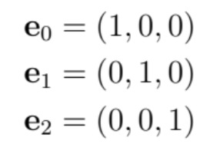
State space of classical systems
System S has property P. e.g. system = a ball and we focus on it’s colour P = {‘red’, ‘blue’, ‘green’}
The state of the system (the ball) is a description of what its colour is.
If this is not known with certainty, it’s a description of the probabilities with which it could be different colours
r = ( prob(‘red’), prob(‘blue’), prob(‘green’)
The states of ‘perfect’ knowledge are call pure states and we label them

Slide 57
State space of classical systems
System S has property P. e.g. system = a ball and we focus on it’s colour P = {‘red’, ‘blue’, ‘green’}
The state of the system (the ball) is a description of what its colour is.
If this is not known with certainty, it’s a description of the probabilities with which it could be different colours
r = ( prob(‘red’), prob(‘blue’), prob(‘green’)
What does the state r = (1/3, 1/3, 1/3) correspond to?

Slide 58
State space of classical systems
System S has property P. e.g. system = a ball and we focus on it’s colour P = {‘red’, ‘blue’, ‘green’}
The state of the system (the ball) is a description of what its colour is.
If this is not known with certainty, it’s a description of the probabilities with which it could be different colours
r = ( prob(‘red’), prob(‘blue’), prob(‘green’)
What does the state r = (1/3, 1/3, 1/3) correspond to? The case where you have no clue what colour the ball is. This is called the maximally mixed state.

Slide 59
State space of classical systems
System S has property P. e.g. system = a ball and we focus on it’s colour P = {‘red’, ‘blue’, ‘green’}
The state of the system (the ball) is a description of what its colour is.
If this is not known with certainty, it’s a description of the probabilities with which it could be different colours
r = ( prob(‘red’), prob(‘blue’), prob(‘green’)
What does the state r = (1/3, 1/3, 1/3) correspond to? The case where you have no clue what colour the ball is. This is called the maximally mixed state.
And we can write it in terms of the basis states as r = 1/3 e₁ + 1/3 e₂ + 1/3 e₃

Slide 60
State space of classical systems
System S has property P. e.g. system = a ball and we focus on it’s colour P = {‘red’, ‘blue’, ‘green’}
The state of the system (the ball) is a description of what its colour is.
If this is not known with certainty, it’s a description of the probabilities with which it could be different colours
r = ( prob(‘red’), prob(‘blue’), prob(‘green’)
The most general state of the system can be written as r = (r₁, r₂, r₃)
What constraints are needed here?

Slide 61
State space of classical systems
System S has property P. e.g. system = a ball and we focus on it’s colour P = {‘red’, ‘blue’, ‘green’}
The state of the system (the ball) is a description of what its colour is.
If this is not known with certainty, it’s a description of the probabilities with which it could be different colours
r = ( prob(‘red’), prob(‘blue’), prob(‘green’)
The most general state of the system can be written as r = (r₁, r₂, r₃)
What constraints are needed here? r_{i} > 1 and

Slide 62
State space of classical systems
System S has property P. e.g. system = a ball and we focus on it’s colour P = {‘red’, ‘blue’, ‘green’}
The state of the system (the ball) is a description of what its colour is.
If this is not known with certainty, it’s a description of the probabilities with which it could be different colours
r = ( prob(‘red’), prob(‘blue’), prob(‘green’)
The most general state of the system can be written as r = (r₁, r₂, r₃) = r₁ e₁ + r₂ e₂ + r₃ e₃
What constraints are needed here? r_{i} > 1 and
Any state can be written as a convex combination of the basis states

Slide 63
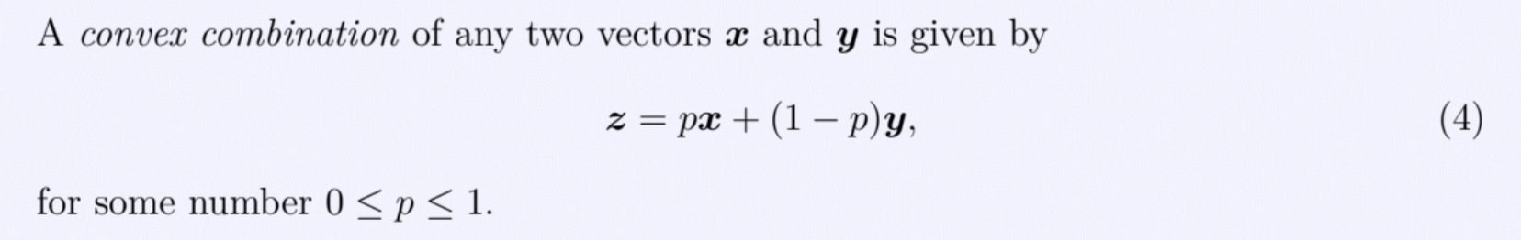
State space of classical systems
The most general state of the system can be written as r = (r₁, r₂, r₃) = r₁ e₁ + r₂ e₂ + r₃ e₃
What constraints are needed here? r_{i} > 1 and
Any state can be written as a convex combination of the basis states

Slide 64
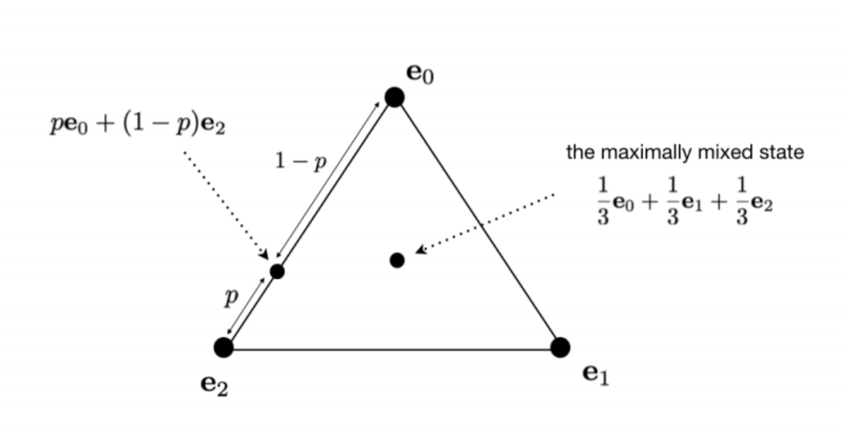
State space of classical systems
The most general state of the system can be written as r = (r₁, r₂, r₃) = r₁ e₁ + r₂ e₂ + r₃ e₃
What constraints are needed here? r_{i} > 1 and
Any state can be written as a convex combination of the basis states
State space of a classical system S is a triangle with computational basis states at its vertices.
Any point r lies within the triangle

Slide 65
State space of classical systems
The most general state of the system can be written as r = (r₁, r₂, r₃) = r₁ e₁ + r₂ e₂ + r₃ e₃
What constraints are needed here? r_{i} > 1 and
Any state can be written as a convex combination of the basis states
What is the shape of the state space if the ball could only be red or green?

Slide 66
State space of classical systems
The most general state of the system can be written as r = (r₁, r₂, r₃) = r₁ e₁ + r₂ e₂ + r₃ e₃
What constraints are needed here? r_{i} > 1 and
Any state can be written as a convex combination of the basis states
What is the shape of the state space if the ball could only be red or green?
- A line

Slide 67
State space of classical systems
The most general state of the system can be written as r = (r₁, r₂, r₃) = r₁ e₁ + r₂ e₂ + r₃ e₃
What constraints are needed here? r_{i} > 1 and
Any state can be written as a convex combination of the basis states
What is the shape of the state space if the ball could be red, blue, green or yellow?
- A tetrahedral

Slide 68
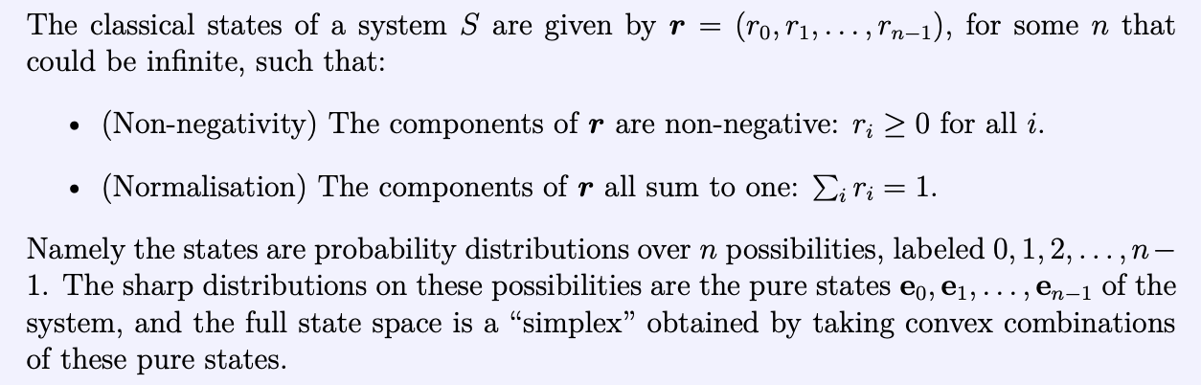
State space of classical systems
(A simplex is just a simple convex shape: in 1–dimension it is simply a line segment, in 2– dimensions it is as triangle, in 3–dimensions it is a tetrahedron etc…)

Slide 69
What can we do to a (classical) system?
1) Transform system S
2) Measure system S

Slide 70

Transformations to classical systems
1) Transform system S $r →s$

Slide 71

Transformations to classical systems
1) Transform system S $r →s$
Applying a transformation to a convex combination is equivalent to applying a transformation and then taking a convex combination
Need
Therefore L must be linear
Can see this by thinking about how adding randomness then applying transformation OR applying transformation then adding randomness must commute

Slide 72
Measurements of classical systems
2) Measure system S
Every measurement can be seen as a question we ask the system

Slide 73
Measurements of classical systems
2) Measure system S
Every measurement can be seen as a question we ask the system
M₁: “What is the colour of S?” Three possible outcomes ‘red’, ‘green’ or ‘blue’

Slide 74
Measurements of classical systems
2) Measure system S
Every measurement can be seen as a question we ask the system
M₁: “What is the colour of S?” Three possible outcomes ‘red’, ‘green’ or ‘blue’
M₂: “Is S blue?” Two possible outcomes ‘yes’ or ‘no’

Slide 75
Measurements of classical systems
M₂: “Is S blue?” Two possible outcomes ‘yes’ or ‘no’. Label these answers 0 and 1.
Recall that: r = ( prob(‘red’), prob(‘green’), prob(‘blue’))
We want to know the probability of getting ‘no’ (0) and the probability of getting ‘yes’ (1).

Slide 76
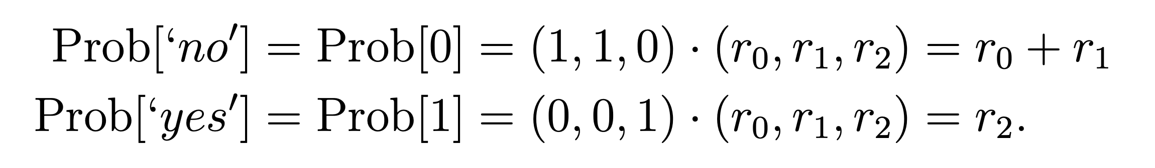
Measurements of classical systems
M₂: “Is S blue?” Two possible outcomes ‘yes’ or ‘no’. Label these answers 0 and 1.
Recall that: r = ( prob(‘red’), prob(‘green’), prob(‘blue’))
We want to know the probability of getting ‘no’ (0) and the probability of getting ‘yes’ (1).
The following recipe clearly works…

Slide 77
Measurements of classical systems
M₂: “Is S blue?” Two possible outcomes ‘yes’ or ‘no’. Label these answers 0 and 1.
Recall that: r = ( prob(‘red’), prob(‘green’), prob(‘blue’))
We want to know the probability of getting ‘no’ (0) and the probability of getting ‘yes’ (1).
The following recipe clearly works…
m₀
M₂ = ( m₀ , m₁ )
m₀ ₌ (1, 1, 0)
m₁ ₌ (0, 0, 1)
m₁

Slide 78
Measurements of classical systems
M₁: “What colour is S?” Three possible outcomes ‘red’, ‘green’ or ‘blue’ Label these answers 0, 1, 2.
Recall that: r = ( prob(‘red’), prob(‘green’), prob(‘blue’))
What form does M₁ take?

Slide 79
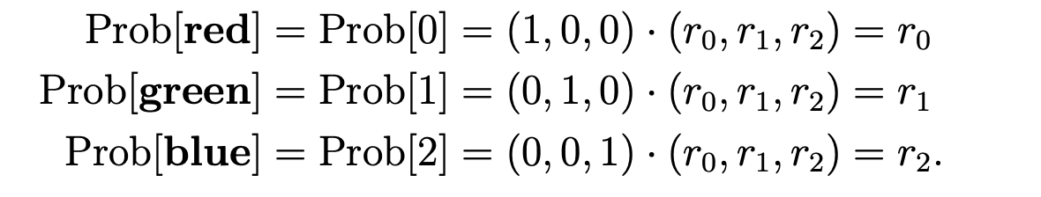
Measurements of classical systems
M₁: “What colour is S?” Three possible outcomes ‘red’, ‘green’ or ‘blue’ Label these answers 0, 1, 2.
Recall that: r = ( prob(‘red’), prob(‘green’), prob(‘blue’))
What form does M₁ take?
M₁ = ( m₀ , m₁, m₂)
m₀ ₌ (1, 0, 0)
m₁ ₌ (0, 1, 0)
m₂ ₌ (0, 0, 1)

Slide 80
Measurements of classical systems
M₁: “What colour is S?” Three possible outcomes ‘red’, ‘green’ or ‘blue’ Label these answers 0, 1, 2.
M₁ = ( m₀ , m₁, m₂)
m₀ ₌ (1, 0, 0)
m₁ ₌ (0, 1, 0)
m₂ ₌ (0, 0, 1)
M₂: “Is S blue?” Two possible outcomes ‘yes’ or ‘no’. Label these answers 0 and 1.
M₂ = ( m₀ , m₁ )
m₀ ₌ (1, 1, 0)
m₁ ₌ (0, 0, 1)

Slide 81

Measurements of classical systems
M₁: “What colour is S?” Three possible outcomes ‘red’, ‘green’ or ‘blue’ Label these answers 0, 1, 2.
M₁ = ( m₀ , m₁, m₂)
m₀ ₌ (1, 0, 0)
m₁ ₌ (0, 1, 0)
m₂ ₌ (0, 0, 1)
M₂: “Is S blue?” Two possible outcomes ‘yes’ or ‘no’. Label these answers 0 and 1.
M₂ = ( m₀ , m₁ )
m₀ ₌ (1, 1, 0)
m₁ ₌ (0, 0, 1)
Components of each m_{k} must be positive
And need
General rule

Slide 82
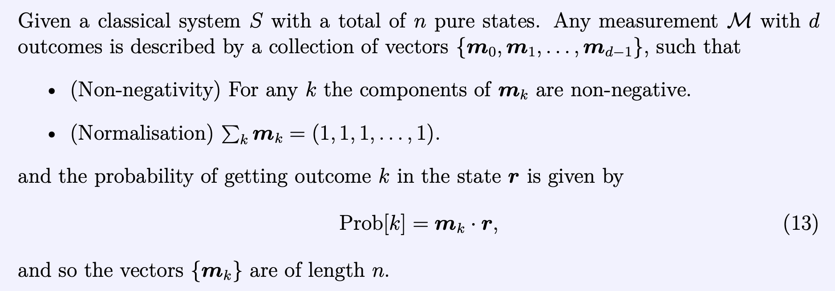
Measurements of classical systems

Slide 83
Summary for classical systems
Notes:
Powerful but abstract.
No discussion of physical systems with particular Hamiltonians obeying different laws…

Slide 84
Quantum systems
Same broad picture but now with quantum systems

Slide 85
Recap: classical states

Slide 86
Quantum states
How to make it quantum….
(a Hermitian matrix)

Slide 87
Quantum states
How to make it quantum….
(a Hermitian matrix)
Non-negativity ensured by positivity of eigenvalues ( or simply )

Slide 88
Quantum states
How to make it quantum….
(a Hermitian matrix)
Non-negativity ensured by positivity of eigenvalues ( or simply )
Normalization -

Slide 89
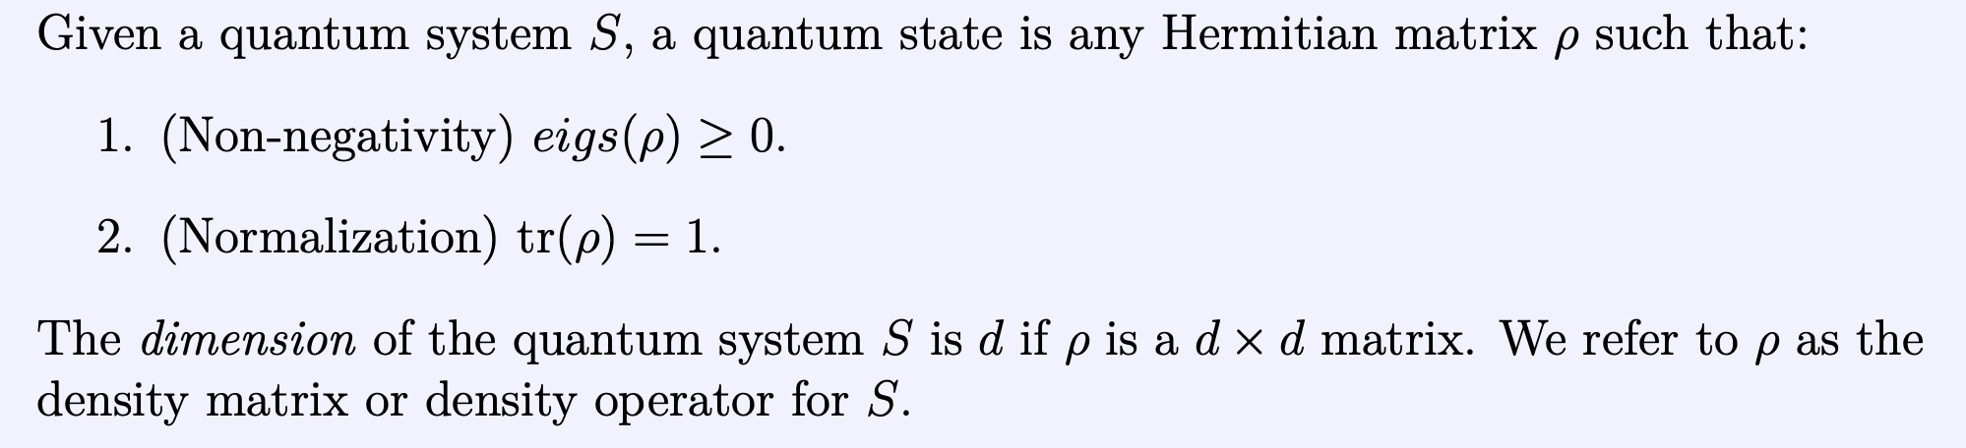
Quantum states

Slide 90
Recap: transformations to classical systems
where L is a linear transformation

Slide 91
Transformations to quantum systems
where L is a linear transformation

Slide 92
Recap: Measurements of classical systems

Slide 93
Measurements of quantum systems
vector goes to matrix

Slide 94
Measurements of quantum systems
vector goes to matrix
& dot product goes to matrix inner product

Slide 95
Measurements of quantum systems
vector goes to matrix
& dot product goes to matrix inner product

Slide 96
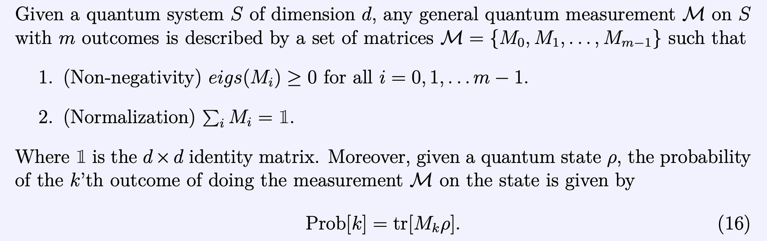
Measurements of quantum systems
vector goes to matrix
& dot product goes to matrix inner product

Slide 97
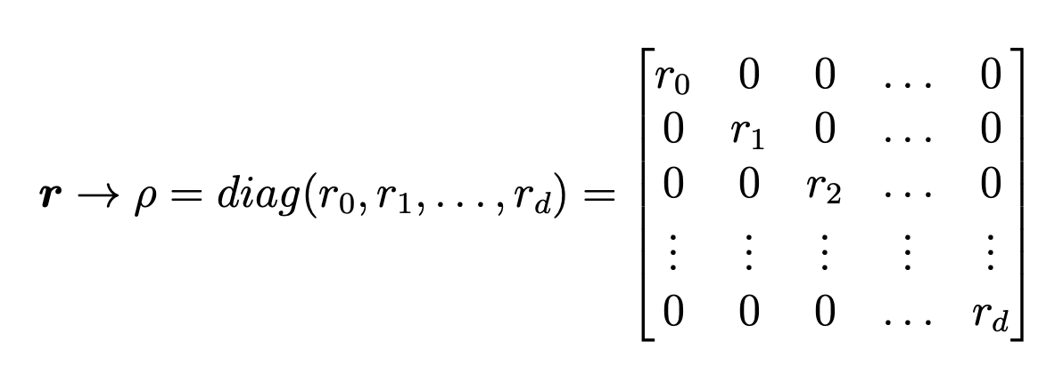
Classical theory is a subset of quantum theory
Essentially we can always embed classical physics within the quantum formalism just by placing the classical state/measurement vector on the diagonal and leaving all the off-diagonals blank.
& similarly for measurements
e.g.
In this case we have and we get back what we had classically.
Similar tricks can be played with evolutions.

Slide 98
Quantum (Information) Theory in a slide….
Quantum states
Quantum evolutions
Quantum measurements

Slide 99
Timeline of the next few weeks
Today: (Finishing introducing/recapping the basics)
Part 1 – Multi qubit quantum states (tensor product + partial trace)
Part 2 – Unitary evolutions
Week 3:
Part 1 – More on multi qubit quantum states
(Purifications + some philosophizing on proper/improper mixtures)
Part 2 – General Quantum Measurements (examples of POVMS)
Week 4:
Part 1 – General Quantum Measurements (Naimarks dilation theorem)
Part 2 – Intro to quantum channels
Weeks 5 & 6 – More advanced representations of quantum channels

Slide 100
Recap: State space of a single qubit ( 2 by 2 Hermitian matrix with Tr[$ρ$]=1 and eigs($ρ$) $≥0$)
Any single qubit state can be represented by a unit vector r
State space of a single qubit is a ball of unit 1

Slide 101
State space of classical systems
System S has property P. e.g. system = a ball and we focus on it’s colour P = {‘red’, ‘blue’, ‘green’}
The state of the system (the ball) is a description of what its colour is.
If this is not known with certainty, it’s a description of the probabilities with which it could be different colours
r = ( prob(‘red’), prob(‘blue’), prob(‘green’)
The most general state of the system can be written as r = (r₁, r₂, r₃)

Slide 102
Measurements of classical systems
M₁: “What colour is S?” Three possible outcomes ‘red’, ‘green’ or ‘blue’ Label these answers 0, 1, 2.
M₁ = ( m₀ , m₁, m₂)
m₀ ₌ (1, 0, 0)
m₁ ₌ (0, 1, 0)
m₂ ₌ (0, 0, 1)
M₂: “Is S blue?” Two possible outcomes ‘yes’ or ‘no’. Label these answers 0 and 1.
M₂ = ( m₀ , m₁ )
m₀ ₌ (1, 1, 0)
m₁ ₌ (0, 0, 1)
Components of each m_{k} must be positive
And need
General rule

Slide 103
Measurements of classical systems

Slide 104
Measurements of quantum systems
vector goes to matrix

Slide 105
Measurements of quantum systems
vector goes to matrix
& dot product goes to matrix inner product

Slide 106
Measurements of quantum systems
vector goes to matrix
& dot product goes to matrix inner product

Slide 107
Measurements of quantum systems
Measurement operator correspond to different possible answers to a question you can ask about a system
vector goes to matrix
& dot product goes to matrix inner product

Slide 108
Measurements of quantum systems
Measurement operator correspond to different possible answers to a question you can ask about a system
Doesn’t say anything about how measurement is realized
Doesn’t say anything about post measurement state
POVMs
‘Positive Operator Value Measurements’

